Slide 1
KP Skillsoft Program Learning for you!
Enterprise Learning
Talent & Organizational Performance

Slide 2
KP Skillsoft Program Overview
KP-wide program of on-demand Web-based courses and videos covering:
Business skills
Software applications and functionality
Technical (IT) courses (SkillPort)
KP Learn - 2,500+ courses and videos on software applications and business skills
KP SkillPort - 5,000 technical (IT) courses and videos + the same business skills and desktop applications courses and videos as KP Learn

Slide 3
Skillsoft Audiences
Represented LMP Employees
BHMT or Ed Fund
KP employees – Regional, National Functions, Program Office
Access on KP Learn
Paid by BHMT or Ed Fund
Immediate / automatic access to Skillsoft (no manager approval / no recharge)
Continuation of “in progress” courses from year to year
Unlimited courses
Access via KP Learn
Manager’s $35 recharge approval (2020 calendar year) and completion of pre-requisite course
Annual license (calendar year)
One-time charge / Unlimited courses
Continuation of “in progress” courses from year to year
*Non-KP employees (contractors, interns, guests) are not eligible for the Skillsoft program

Slide 4
Enroll/Launch - Skillsoft access course
Represented LMP Employees
BHMT or Ed Fund
KP employees – Regional, National Functions, Program Office
Log in to KP Learn, you will see a course sitting in your Enrollments (“Me” tab) titled“2020 Ben Hudnall Skillsoft Subscription” or “2020 Ed Fund Skillsoft Subscription” (depending on what union affiliation your employees belong to).
Simply launch and complete this very short (2 screens) course. When it is complete, it will unlock all the Skillsoft courses on KP Learn for you in 2020 and you will not need to launch this course again. No manager approval or recharge is needed.
If you do not choose to access Skillsoft courses in 2020, there is no need to launch it. Simply leave it on your “Me” tab in case you change your mind later this year.
Log-in to KP Learn—search for and enroll in the course, “2020 Skillsoft Library Recharge Approval”. When you click on “Yes” to request approval for the $35 recharge, KP Learn will notify your manager via email of your request.
Your manager will receive an email with information and link to review/approve request (this is done in KP Learn in the Team Enrollments page).
Once your manager approves your request you will receive an email notifying you with information for completing access to the Skillsoft courses. Log into KP Learn and navigate to your “Me” tab and click on the“2020 Skillsoft Library Recharge Approval” course to complete the access process.

Slide 5
Skillsoft Course Libraries in KP Learn -
Business Skills
Desktop/Productivity
Courses and videos covering business skills include curricula and series in topics like:
Communication
Leadership
Team building
Presentations
Project management
Coaching
Emotional intelligence
Analysis
For software applications and device functionality, there are courses and videos in the following, and more:
Excel, Word, and PowerPoint
Access
Acrobat
Office 365
iPhones and iPads
SharePoint
Windows
Internet Explorer

Slide 6
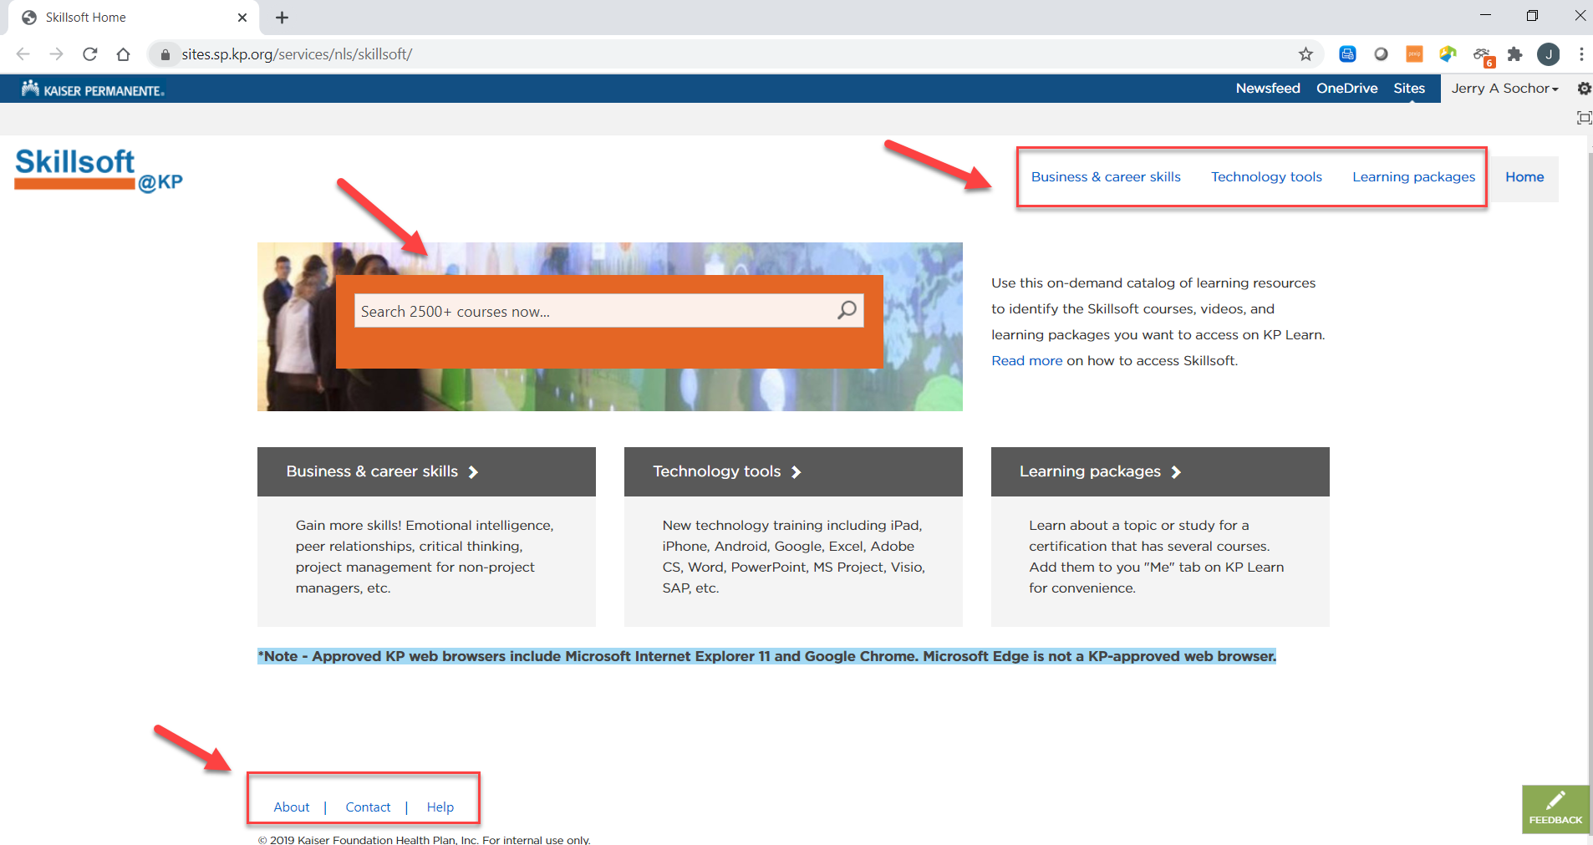
Finding Courses - Skillsoft SharePoint Site

Slide 7
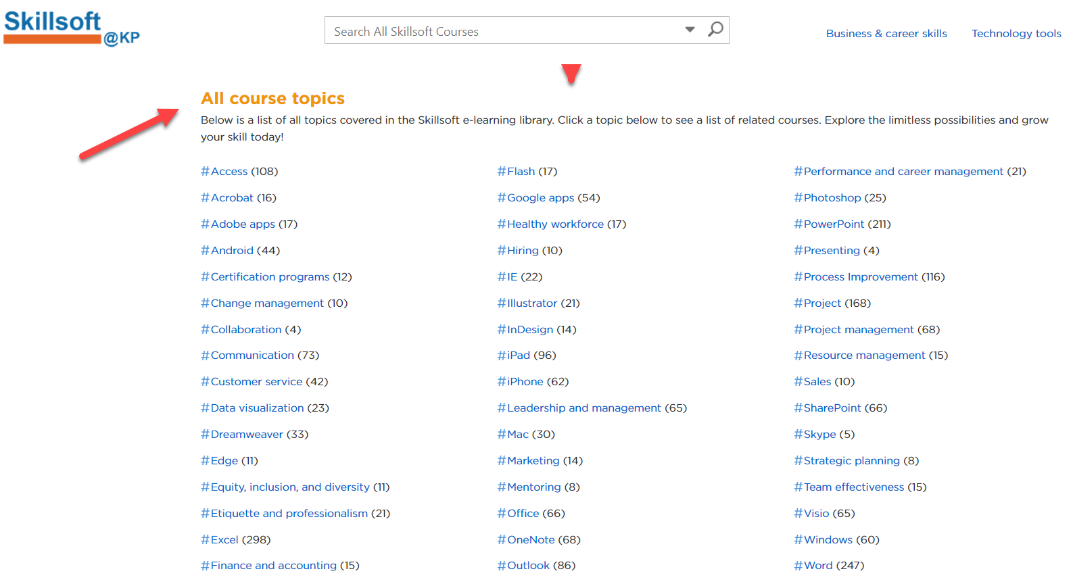
Finding Courses - Skillsoft SharePoint by Topic

Slide 8
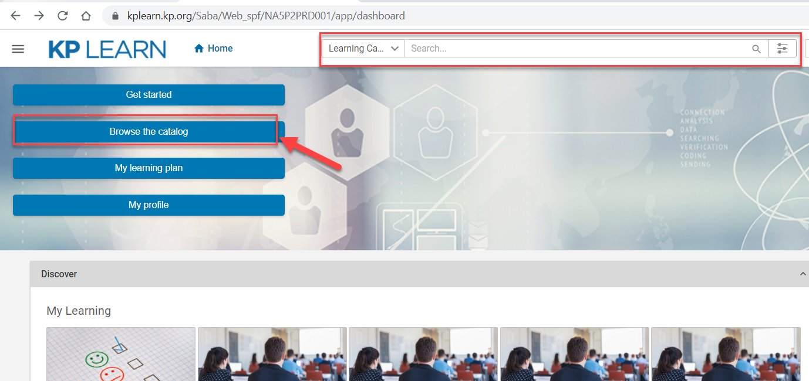
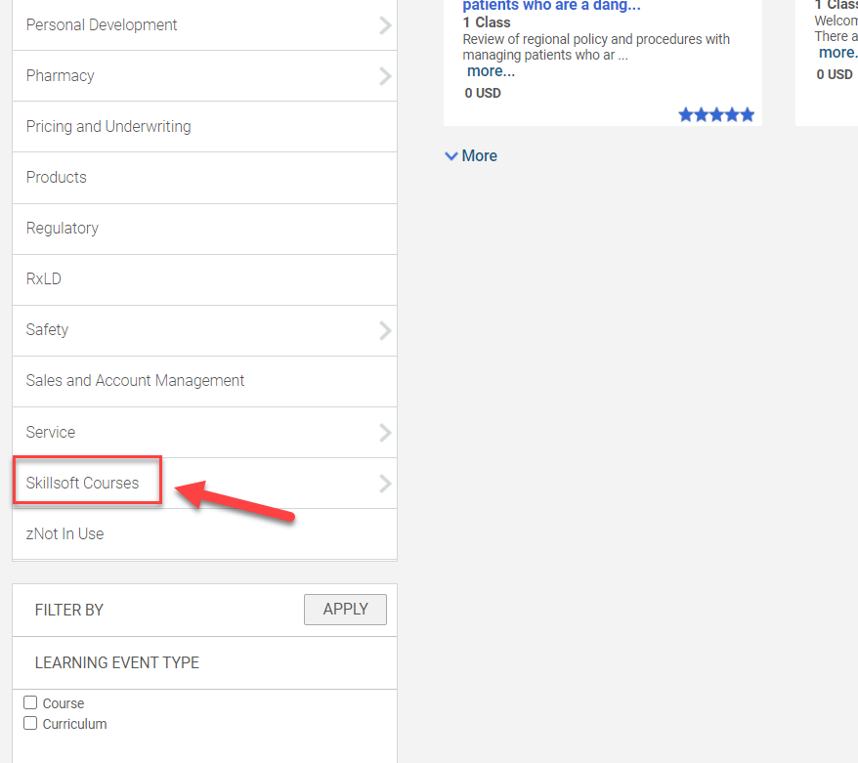
Finding Courses - KP Learn

Slide 9
Resources
Skillsoft Program information and course catalog: https://sites.sp.kp.org/services/nls/skillsoft/
How to Access Skillsoft: https://sites.sp.kp.org/services/nls/skillsoft/help
Email to: KPSkillsoft@KP.org
Skillsoft Program manager - Jerry Sochor: 303-306-2989 jerry.a.sochor@KP.org

Slide 10
Thank You! Happy Learning!

